Slide 1

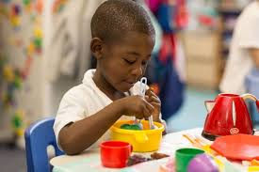
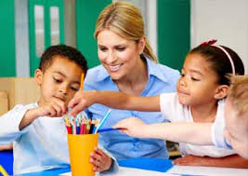

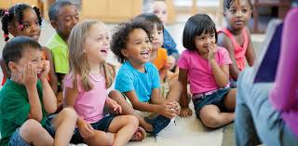
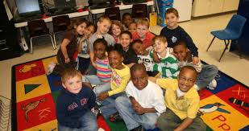
So Your Child is Going to Kindergarten!
Shirlene Jones

Slide 2
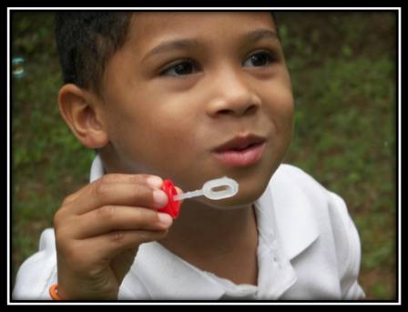
Kindergarten provides your child with an opportunity
to learn and practice the essential social, emotional, problem-solving, and study skills that they will use throughout their schooling.
The development of self-esteem is one of the important goals of kindergarten. This is the process of helping your child feel good about who he or she is and confident in their ability to tackle the challenges of learning.
Kindergarten teaches cooperation: the ability to work, learn, and get along with others.

Slide 3



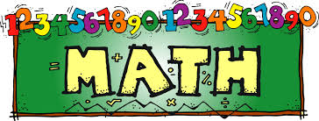
What Will Your Child Learn in Kindergarten?
Kindergarten Units of Study
Reading/Language Arts
Math
Science
Social Studies
Health/
Social Emotional Learning(SEL)

Slide 4

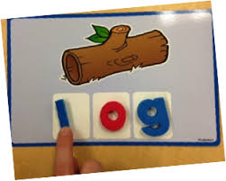
For Reading / Language Arts your child will begin:
1. To transition from oral to written literacy.
2. They begin to demonstrate their understanding of the organizational and basic features of print as they learn to track print and distinguish words from pictures and letters from words.
3. To learn the basics of sound-print code and begin to develop comprehension strategies that will enable them to manipulate grade-level texts of appropriate complexity, including both story books and simple informational texts.

Slide 5
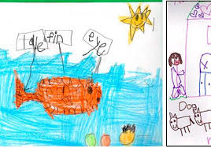
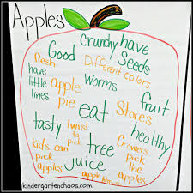

4. To connect their inquiries and responses directly to the text and identify main ideas.
5. Will develop the ability to write letters and represent words with letters, identifying some high-frequency sight words and understandings of basic conventions of language.
6. Continue to increase the complexity of their spoken language and to use language in both one-on-one and group settings.

Slide 6

Kindergarten Math Students are expected to:
1. Make sense of problems and persevere in solving them. Students make sense of problems involving rote counting, recognizing counting patterns, and identifying quantities of items.
2. Reason abstractly and quantitatively. Students demonstrate abstract reasoning by writing numerals to represent an amount of objects counted, creating a set of objects to match a given number, and selecting the correct number card to continue a counting sequence.
3. Construct viable arguments and critique the reasoning of others. Students begin to develop the ability to reason and analyze situations by considering questions such as, “How do you know you counted correctly?”, and by asking classmates to explain how they found their answer.

Slide 7
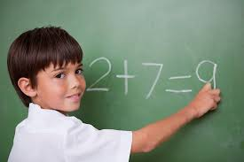
4. Model with mathematics. Students use objects, numbers, and drawings to represent quantities of objects and counting sequence.
5. Use appropriate tools strategically. Students will use counters, connecting cubes and ten frames to explore counting and cardinality.
6. Attend to precision. Students will build their mathematical vocabulary by expressing their ideas and explaining their reasoning using words with regard to quantity and cardinality.

Slide 8
Kindergarten Science students learn:
Why things move and note the various patterns in their environment (e.g., the sun and the moon appear and disappear in the sky).
To use whole numbers to describe scientific data and how to identify parts of things (i.e. tools and toys).
Kindergarteners use their senses (sight, smell, taste, touch, and sound)
To group objects and to make observations about the physical world by describing, comparing, and sorting items according to physical attributes (i.e. number, shape, texture, size, weight, color, and motion).
Learn to follow rules to stay safe..

Slide 9
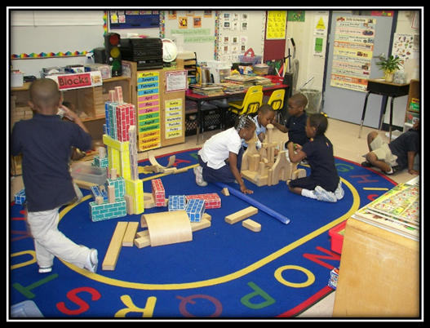
In kindergarten, the students begin to understand the foundations of the Social Studies strands:
History, geography, government, and economics.
Students begin their introduction to United States history through the study of important American holiday and symbols.
Basic concepts of cultural and physical geography are presented.
Civics provides students with an introduction to
rules and character traits of good citizens.
Basic economic concepts are also introduced.

Slide 10

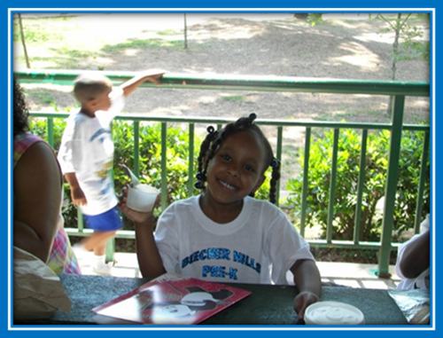
What are the two most important things you as a parent can do to prepare your child for kindergarten?

Slide 11
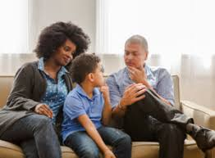
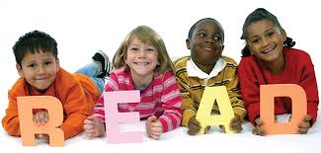
1. Talk to your child.
2. Read, read, read to them daily!

Slide 12
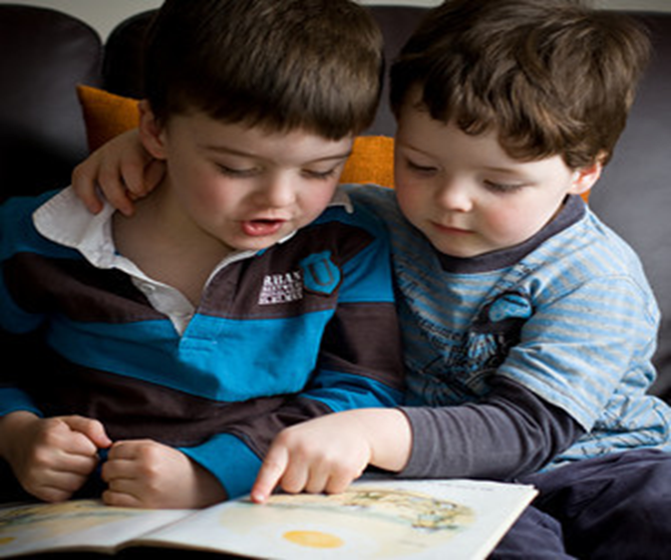

Difficulties with reading are related to a child’s opportunity to read. Daily reading at home provides opportunities for practice, growing interests, and expanding vocabulary and knowledge.

Slide 13

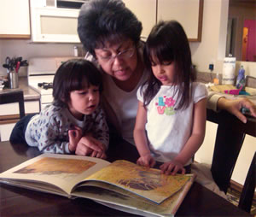
Children who are solid readers:
* perform better in school
* have a healthy self-image
* become lifelong learners
All of the these outcomes lead to our children’s viability in a competitive world.

Slide 14
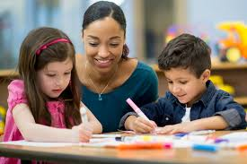
By the end of the year, you can expect
your child to:
Follow classroom rules
Take turn
Cut with scissors
Understand time concepts like: yesterday, today and
tomorrow
Follow directions agreeably and easily
Pay attention for 15 – 20 minutes
Hold writing tools correctly (pencil, marker, crayon, etc.)

Slide 15
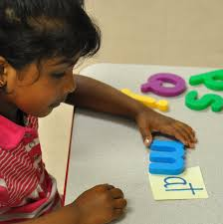
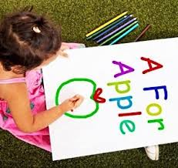
Spell and write his/her first and last name
Recognize and write the letters of the alphabet
Know the relationship between letters and the sounds they make
Blend words (s u n – sun)
Recognize sight words
Read simple sentences
Write consonant-vowel-consonant(CVC) words such as bat and fan

Slide 16
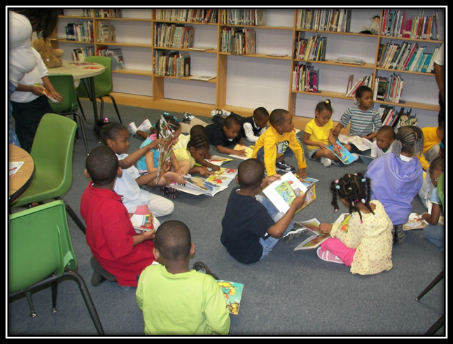
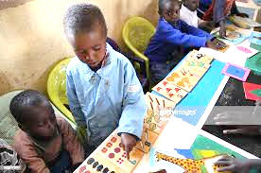
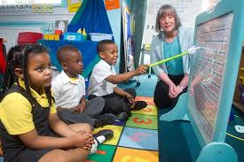
Retell a story that has been read aloud
Show an opinion through drawing, writing, or speaking (e.g., ”My favorite book is…”)
Identify and be able to write numbers from 0 – 20
Count to 100 by ones and tens
Do addition problems with sums up to 10
Do subtraction problems with numbers 0 - 10

Slide 17
Let’s talk about one of the major things that can hinder your child's success in school:
Your child’s attendance is a critical component to
his or her success in school!!!

Slide 18
Students who are chronically absent are less likely to read proficiently by the time they finish third grade.
If your child’s attendance is 100% he/she is more likely to achieve or exceed their target grade.
If your child’s attendance falls below 90% he/she is likely to achieve one grade lower.
If your child’s attendance falls below 80% he/she is likely to achieve two grades lower.

Slide 19

Most frequently asked Questions?

